Slide 1


Redux
Time Travel Through
Predictable Application States
ReactJS Bangkok 1.0.0
Arnupharp Viratanapanu & Supasate Choochaisri

Slide 2


Arnupharp Viratanapanu (Top)
Co-founder Larngear Technology / Streaming
github.com/topscores
Supasate Choochaisri (Ping)
Co-founder Larngear Technology / Streaming
github.com/supasate
<who>
</who>

Slide 3
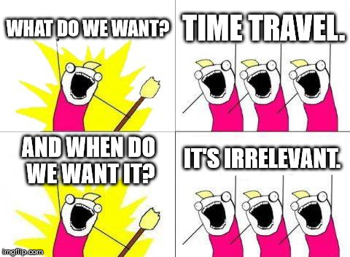
Why’re we here?

Slide 4

React
(state) => (<ui />)

Slide 5
View contains states and handlers
State
todos: [
{
title:'Feed cat',
completed:false
},
{
title:'Clean room',
completed:false
}
]
TodoApp
State
Handler
props
Child Components
TodoInput
TodoList
props
TodoItem

Slide 6
View contains states and handlers
TodoApp
Dashboard
State
Handler
Todo: #active: 3
#completed: 5
props
Child Components
TodoInput
TodoList
props
TodoItem

Slide 7
View contains states and handlers
RealTodoApp
State
Handler
props
props
TodoApp
Dashboard
props
Child Components
Todo: #active: 3
#completed: 5
TodoInput
TodoList
props
TodoItem

Slide 8
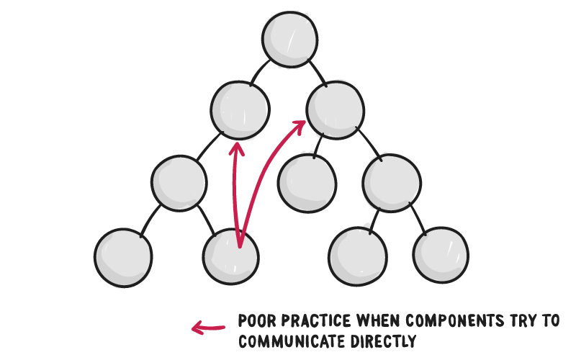
Problem with React
https://css-tricks.com/learning-react-redux/

Slide 9
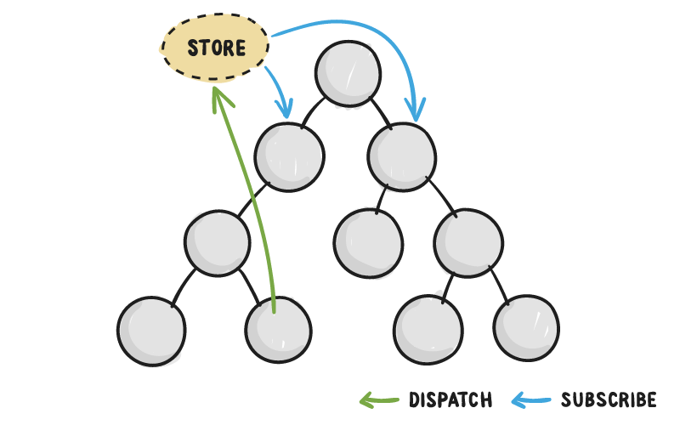
Redux
https://css-tricks.com/learning-react-redux/

Slide 10
Architecture
Store
State
Reducer
dispatch(action)
View

Slide 11
Architecture
Store
State
Reducer
{ num: 0 }
dispatch(action)
View

Slide 12
Architecture
Store
State
Reducer
action
{ num: 0 }
dispatch(action)
View

Slide 13
Architecture
Store
State
Reducer
action
{ num: 0 }
dispatch(action)
View

Slide 14
Action
Plain object that describes changes
{ type: 'ADD', payload: 1, }

Slide 15
Action creator
Function that creates an action
const add = (num) => ({ type: 'ADD', payload: num, })

Slide 16
Architecture
Store
action
State
Reducer
{ type: 'ADD', payload: 1 }
{ num: 0 }
dispatch(action)
View

Slide 17
Architecture
Store
action
State
Reducer
{ type: 'ADD', payload: 1 }
{ num: 0 }
dispatch(action)
View

Slide 18
Architecture
Store
current state
action
State
{ num: 0 }
Reducer
{ type: 'ADD', payload: 1 }
{ num: 0 }
dispatch(action)
View

Slide 19
Architecture
Store
current state
action
State
{ num: 0 }
Reducer
{ type: 'ADD', payload: 1 }
next state
{ num: 1 }
{ num: 0 }
dispatch(action)
View

Slide 20
Reducer
Pure functions: no side effects, no state mutation
const reducer = (state = { num: 0 }, action) => { switch(action.type) { case 'ADD': return {
num: state.num + action.payload } default: return state } }

Slide 21
Reducer
Pure functions: no side effects, no state mutation
const reducer = (state, action) => { switch(action.type) { case 'ADD': return {
num: state.num + action.payload } default: return { num: 0 } } }
Don’t mutate state, Copy it !!!
Example of state mutation (don't do this)
state.num += action.payload
return state

Slide 22
Architecture
const reducer = (state, action) => { switch(action.type) { ...
Store
current state
State
{ num: 0 }
action
Reducer
next state
{ type: 'ADD', payload: 1 }
{ num: 1 }
{ num: 0 }
dispatch(action)
View

Slide 23
Architecture
Store
const reducer = (state, action) => { switch(action.type) { ...
current state
State
{ num: 0 }
action
Reducer
next state
{ type: 'ADD', payload: 1 }
{ num: 1 }
{ num: 1 }
dispatch(action)
View

Slide 24
Store in action
A plain object with a few methods
getState()
dispatch(action)
subscribe(listener)

Slide 25
Store in action
import { createStore } from 'redux' import reducer from 'path/to/reducer'
let store = createStore(reducer)
store.subscribe(() => { console.log(store.getState()) }) store.dispatch(add(5)) store.dispatch(add(7))

Slide 26
Store in action
import { createStore } from 'redux' import reducer from 'path/to/reducer'
let store = createStore(reducer)
store.subscribe(() => { console.log(store.getState()) }) store.dispatch(add(5)) store.dispatch(add(7))
{ num: 5 }
{ num: 12 }

Slide 27
3 Principles of Redux

Slide 28
#1 Single Source of Truth
Single store, single state tree
{ todos: [
{ text: 'Eat food', completed: true }, { text: 'Exercise', completed: false }
], filter: 'SHOW_COMPLETED' }

Slide 29
#1 Single Source of Truth
Action
{ type: 'ADD_TODO', text: 'Go to swimming pool' } { type: 'TOGGLE_TODO', index: 1 } { type: 'SET_FILTER', filter: 'SHOW_ALL' }

Slide 30
#1 Single Source of Truth
Reducer
filterReducer = (state = 'SHOW_ALL', action) => { if (action.type === 'SET_FILTER') { return action.filter } else { return state } }

Slide 31
#1 Single Source of Truth
Reducer
todoReducer = (state = [], action) => { switch (action.type) { case 'ADD_TODO': return state.concat([{ text: action.text, completed: false }]) case 'TOGGLE_TODO': return state.map((todo, index) => action.index === index ? { text: todo.text, completed: !todo.completed } : todo ) default: return state } }

Slide 32
#1 Single Source of Truth
Reducer
rootReducer = (state = {}, action) => { return { todos: todoReducer(state.todos, action), filterReducer: filterReducer(state.filter, action) } }

Slide 33
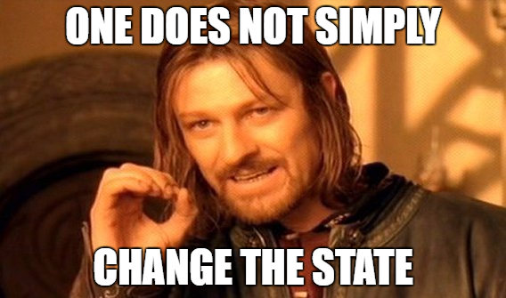
#2 State is Read Only

Slide 34
#2 State is Read Only
Don’t
state.num = state.num + 1
setState({ num: num + 1 })

Slide 35
#2 State is Read Only
Don’t
state.num = state.num + 1
setState({ num: num + 1 })
Do
const add = (num) => ({
type: ADD,
payload: num,
})
store.dispatch(add(1))

Slide 36
#3 Mutation as Pure Function
State
Pure function (reducer)
Next State
Action

Slide 37
Usage with React

Slide 38
npm install --save react-redux

Slide 39
Presentational and Container Component
Container
state
this.props = {
...this.props,
counter,
count = () => (dispatch(add)) }
Store
dispatch(action)
Presentational
(props) => <ui />

Slide 40
Presentational Component
const Counter = (props) => (
<div>
<label>{props.counter}</label>
<button onClick={() => props.count}>Add</button>
</div>
)

Slide 41
Container Component
import { connect } from 'react-redux' CounterContainer = connect( mapStateToProps, mapDispatchToProps )(Counter)
export default CounterContainer

Slide 42
Map state to presentational props
const mapStateToProps = (state) => { return { counter: state.counter, } }

Slide 43
Map dispatch to presentational props
import { add } from './actions/counter' const mapDispatchToProps = (dispatch) => { return { count: () => { dispatch(add(1)) }, } }

Slide 44
Pass store down component tree
import { Provider } from 'react-redux' ...
<Provider store={store}>
<CounterContainer />
</Provider>

Slide 45
Let's see Redux in action

Slide 46
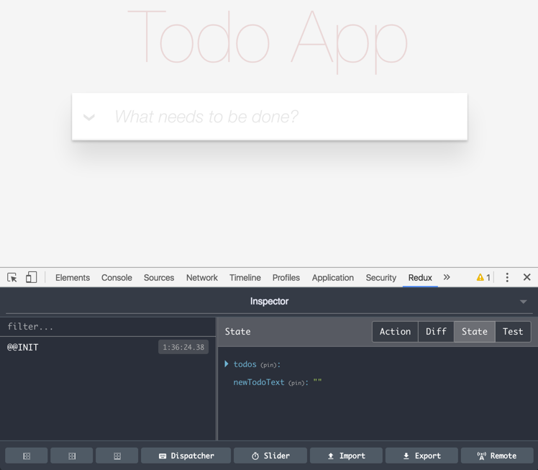

Slide 47
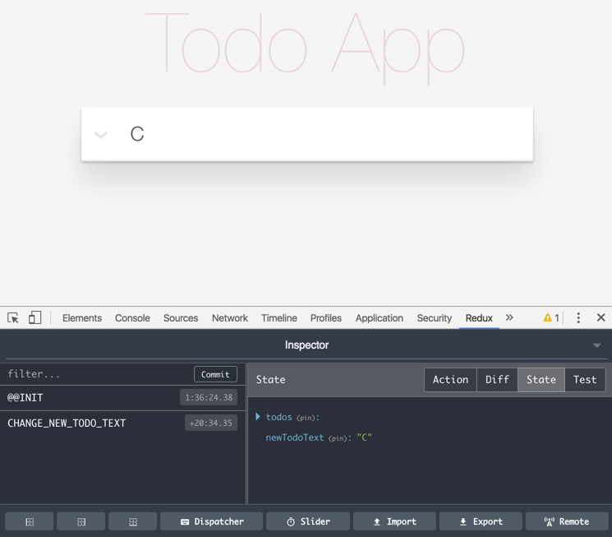

Slide 48
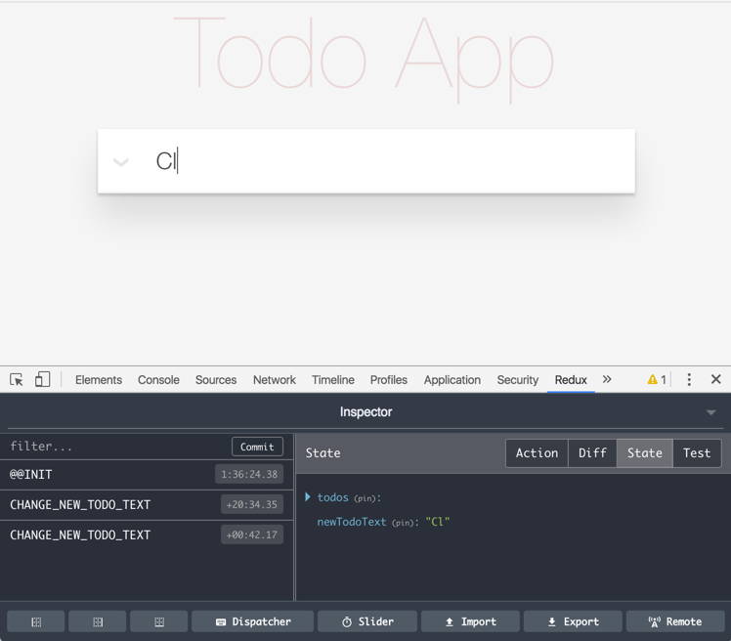

Slide 49
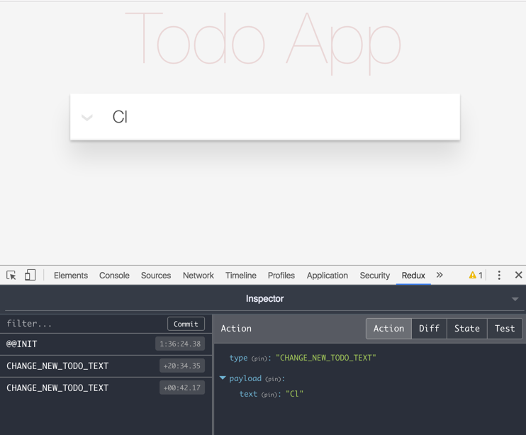

Slide 50
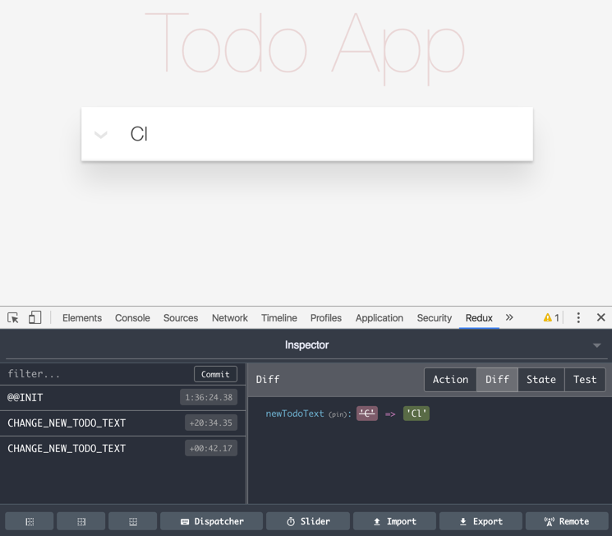

Slide 51
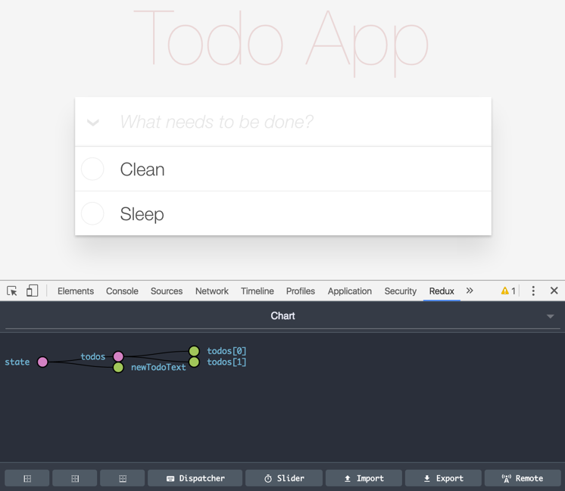

Slide 52
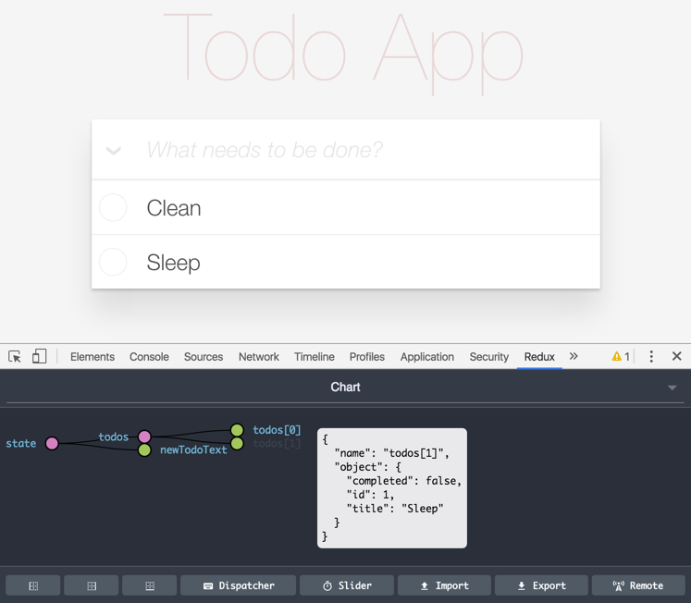

Slide 53
Testing Redux

Slide 54
Testing Redux
Common Tests
Test Action Creator
Test Reducer
Test Middleware
Test Component (React)
Test Container

Slide 55
Testing Redux
Common Tests
Test Action Creator
Test Reducer
Test Middleware
Test Component (React)
Test Container

Slide 56
Think like testing a state machine
State A
Todos: [
{title:'Feed cat', completed:false},
{title:'Clean room', completed:false},
]

Slide 57
Think like testing a state machine
{
type: ADD_TODO,
payload: { title: 'Sleep', completed: false }
}
Action X
State A
Todos: [
{title:'Feed cat', completed:false},
{title:'Clean room', completed:false},
]

Slide 58
Think like testing a state machine
{
type: ADD_TODO,
payload: { title: 'Sleep', completed: false }
}
Action X
State A
State B
Todos: [
{title:'Feed cat', completed:false},
{title:'Clean room', completed:false},
]
Todos: [
{title:'Feed cat', completed:false},
{title:'Clean room', completed:false},
{title:'Sleep', completed:false},
]

Slide 59
describe('todoReducer', () => {
it('should add new todo when receiving addTodo action', () => {
})
})

Slide 60
describe('todoReducer', () => {
it('should add new todo when receiving addTodo action', () => {
const curState = [
{ title: 'Feed cat', completed: false },
]
})
})

Slide 61
describe('todoReducer', () => {
it('should add new todo when receiving addTodo action', () => {
const curState = [
{ title: 'Feed cat', completed: false },
]
const action = {
type: ADD_TODO,
payload: { title: 'Clean room', completed: false },
}
})
})

Slide 62
describe('todoReducer', () => {
it('should add new todo when receiving addTodo action', () => {
const curState = [
{ title: 'Feed cat', completed: false },
]
const action = {
type: ADD_TODO,
payload: { title: 'Clean room', completed: false }
}
const nextState = todoReducer(curState, action)
})
})

Slide 63
describe('todoReducer', () => {
it('should add new todo when receiving addTodo action', () => {
const curState = [
{ title: 'Feed cat', completed: false },
]
const action = {
type: ADD_TODO,
payload: { title: 'Clean room', completed: false },
}
const nextState = todoReducer(curState, action)
const expectedState = [
{ title: 'Feed cat', completed: false },
{ title: 'Clean room', completed: false },
]
})
})

Slide 64
describe('todoReducer', () => {
it('should add new todo when receiving addTodo action', () => {
const curState = [
{ title: 'Feed cat', completed: false },
]
const action = {
type: ADD_TODO,
payload: { title: 'Clean room', completed: false },
}
const nextState = todoReducer(curState, action)
const expectedState = [
{ title: 'Feed cat', completed: false },
{ title: 'Clean room', completed: false },
]
expect(nextState).to.deep.equal(expectedState)
})
})

Slide 65
Completely isolate
behavior from presentation

Slide 66
Series of Actions
State A
Todos: [
{ title: 'Feed cat', completed: false },
{ title: 'Clean room', completed: false },
]

Slide 67
Series of Actions
{
type: ADD_TODO,
payload: { title: 'Sleep', completed: false }
}
Action X
State A
Todos: [
{ title: 'Feed cat', completed: false },
{ title: 'Clean room', completed: false },
]

Slide 68
Series of Actions
{
type: ADD_TODO,
payload: { title: 'Sleep', completed: false }
}
Action X
State A
State B
Todos: [
{ title: 'Feed cat', completed: false },
{ title: 'Clean room', completed: false },
{ title: 'Sleep', completed: false },
]

Slide 69
Series of Actions
{
type: TOGGLE_TODO,
payload: { title: 'Feed cat' }
}
Action X
Action Y
State A
State B
Todos: [
{ title: 'Feed cat', completed: false },
{ title: 'Clean room', completed: false },
{ title: 'Sleep', completed: false },
]

Slide 70
Series of Actions
{
type: TOGGLE_TODO,
payload: { title: 'Feed cat' }
}
Action X
Action Y
State A
State B
State C
Todos: [
{ title: 'Feed cat', completed: true },
{ title: 'Clean room', completed: false },
{ title: 'Sleep', completed: false },
]

Slide 71
Series of Actions
{
type: ADD_TODO,
payload: { title: 'Sleep', completed: false }
}
{
type: TOGGLE_TODO,
payload: { title: 'Feed cat' }
}
Start
State
Expected State
Todos: [
{ title: 'Feed cat', completed: false },
{ title: 'Clean room', completed: false },
]
Todos: [
{ title: 'Feed cat', completed: true },
{ title: 'Clean room', completed: false },
{ title: 'Sleep', completed: false },
]

Slide 72
Remind
Reducer
(state, action) => (nextState)

Slide 73
Remind
Reducer
(state, action) => (nextState)
[1,2,3].reduce((prev, cur) => (prev + cur), 0)

Slide 74
Remind
Reducer
(state, action) => (nextState)
[1,2,3].reduce((prev, cur) => (prev + cur), 0)
-> 0 + 1 = 1

Slide 75
Remind
Reducer
(state, action) => (nextState)
[1,2,3].reduce((prev, cur) => (prev + cur), 0)
-> 0 + 1 = 1
-> 1 + 2 = 3

Slide 76
Remind
Reducer
(state, action) => (nextState)
[1,2,3].reduce((prev, cur) => (prev + cur), 0)
-> 0 + 1 = 1
-> 1 + 2 = 3
-> 3 + 3 = 6

Slide 77
Remind
See something similar?
Reducer
(state, action) => (nextState)
[1,2,3].reduce((prev, cur) => (prev + cur), 0)
-> 0 + 1 = 1
-> 1 + 2 = 3
-> 3 + 3 = 6

Slide 78
Remind
See something similar?
Reducer
(state, action) => (nextState)
[1,2,3].reduce((prev, cur) => (prev + cur), 0)
-> 0 + 1 = 1
-> 1 + 2 = 3
-> 3 + 3 = 6

Slide 79
Remind
See something similar?
Reducer
[action1, action2].reduce((state, action) => (nextState), curState)
[1,2,3].reduce((prev, cur) => (prev + cur), 0)
-> 0 + 1 = 1
-> 1 + 2 = 3
-> 3 + 3 = 6

Slide 80
Remind
See something similar?
Reducer
[action1, action2].reduce(todoReducer, curState)
[1,2,3].reduce((prev, cur) => (prev + cur), 0)
-> 0 + 1 = 1
-> 1 + 2 = 3
-> 3 + 3 = 6

Slide 81
describe('todoReducer', () => {
it('should add new todo when receiving addTodo action', () => {
const curState = [ { title: 'Feed cat', completed: false } ]
})
})

Slide 82
describe('todoReducer', () => {
it('should add new todo when receiving addTodo action', () => {
const curState = [ { title: 'Feed cat', completed: false } ]
const actions = [
{
type: ADD_TODO,
payload: { title: 'Clean room', completed: false },
},
{
type: TOGGLE_TODO,
payload: { title: 'Feed cat' },
}
]
})
})

Slide 83
describe('todoReducer', () => {
it('should add new todo when receiving addTodo action', () => {
const curState = [ { title: 'Feed cat', completed: false } ]
const actions = [
{
type: ADD_TODO,
payload: { title: 'Clean room', completed: false },
},
{
type: TOGGLE_TODO,
payload: { title: 'Feed cat' },
}
]
const nextState = actions.reduce(todoReducer, curState)
})
})

Slide 84
describe('todoReducer', () => {
it('should add new todo when receiving addTodo action', () => {
const curState = [ { title: 'Feed cat', completed: false } ]
const actions = [
{
type: ADD_TODO,
payload: { title: 'Clean room', completed: false },
},
{
type: TOGGLE_TODO,
payload: { title: 'Feed cat' },
}
]
const nextState = actions.reduce(todoReducer, curState)
const expectedState = [
{ title: 'Feed cat', completed: true },
{ title: 'Clean room', completed: false },
]
})
})

Slide 85
describe('todoReducer', () => {
it('should add new todo when receiving addTodo action', () => {
const curState = [ { title: 'Feed cat', completed: false } ]
const actions = [
{
type: ADD_TODO,
payload: { title: 'Clean room', completed: false },
},
{
type: TOGGLE_TODO,
payload: { title: 'Feed cat' },
}
]
const nextState = actions.reduce(todoReducer, curState)
const expectedState = [
{ title: 'Feed cat', completed: true },
{ title: 'Clean room', completed: false },
]
expect(nextState).to.deep.equal(expectedState)
})
})

Slide 86
That's Redux

Slide 87
Two more things

Slide 88
Hot Module Reloading
& Time Travel Debugging
(live demo)

Slide 89
Time Travel
Video from Dan Abramov

Slide 90
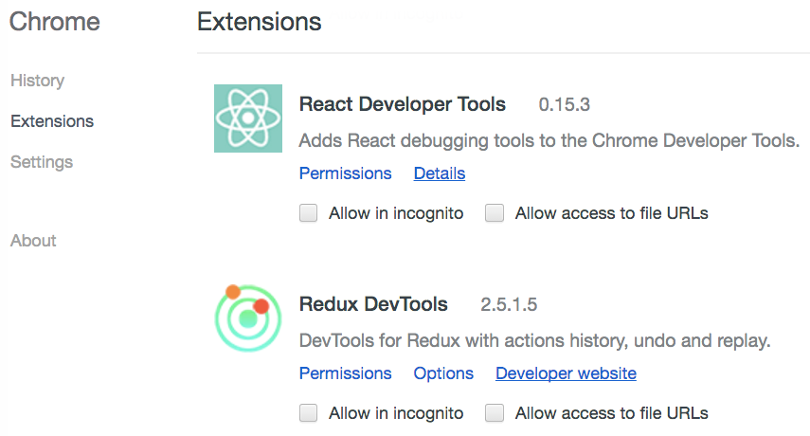
Chrome Extensions: Redux DevTools

Slide 91
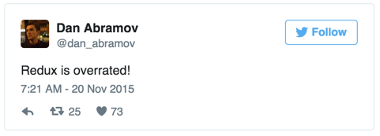
Caution

Slide 92
Thank you
Code:
https://github.com/reactbkk/IntroToRedux
Slide:
http://bit.ly/2bHqHnQ

Slide 93
Backup Slides

Slide 94
Redux Architecture
Store
State
Reducer
State
Reducer
Reducer
dispatch(action)
Action X
Action Y
View

Slide 95

Flux
What’s The Flux?

Slide 96
Architecture
Store
State
Dispatcher
Store
State
View

Slide 97
Architecture
Store
State
Dispatcher
Store
State
View

Slide 98
Architecture
Store
State
Dispatcher
Store
State
Action X
View

Slide 99
Architecture
Store
State
Dispatcher
Store
State
Action X
View

Slide 100
Architecture
Store
State
Dispatcher
Store
State
Action X
View

Slide 101
Architecture
Store
State
Dispatcher
Store
State
Action Y
View

Slide 102
Architecture
Store
State
Dispatcher
Store
State
Action Y
View

Slide 103
Architecture
Store
State
Dispatcher
Store
State
Action Y
View

Slide 104
Architecture
Store
State
Dispatcher
Store
State
Action
View

Slide 105
Enable Redux DevTools

Slide 106
import { createStore } from 'redux' import reducer from './reducer'
let store = createStore(reducer)

Slide 107
import { createStore } from 'redux' import reducer from './reducer'
let store = createStore(reducer,
window.devToolsExtension &&
window.devToolsExtension()
)

